Slide 1

EventEase: Your One-Stop Event Planning and Decoration Platform
Introducing the Management and Decoration Booking Platform: revolutionizing event planning through a centralized platform.
Targeting event planners, venue managers, decorators, and individual clients. Key features include a vendor directory, booking management, design visualization, and integrated payments.

Slide 2
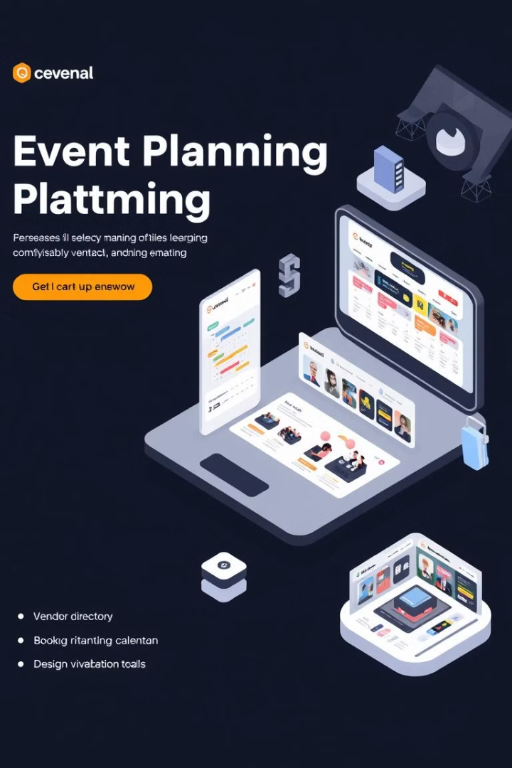
Current Challenges in
Event Management
Lack of a centralized platform for booking decorators and managing events.
Difficulty in comparing vendor services and prices.
Scheduling conflicts and payment inefficiencies.
No real-time availability or instant booking features.
According to Statista, the event management market is projected to reach $1.5 trillion by 2028, yet 60% of planners struggle with vendor coordination.

Slide 3

Our Solution –
The All-in-One Platform
A centralized platform that streamlines event planning by offering easy booking, real-time vendor management, and seamless payments
Key Benefits
Real-time availability checking.
Automated confirmations and contract management.
Integrated payments with multiple gateways.
Design visualization tools for decor previews.

Slide 4




Business Model –
How We Make Money
Platform fee
5-10% commission on every booking.
Subscription Model
Premium vendor listings with annual fees.
Advertisement Revenue:
Promote premium vendors for visibility.

Slide 5

Tech Stack
Title: "Technology Stack Behind Our Platform“ Frontend: React.js → User-friendly UI. Backend: Node.js → Robust and scalable.
Database: MongoDB → Efficient data storage.
Payment Integration: Razorpay/Stripe.

Slide 6

Market Growth & Strategies
Marketing Channels:
Social media ads targeting event planners.
Partnerships with venues and decorators.
Referral programs with discounts.
Expansion Plan:
Phase 1: Local (Pune, Mumbai).
Phase 2: Expand to other metros.

Slide 7

Conclusion
Our platform simplifies event planning by offering a centralized booking system, real-time vendor management, and seamless payment integration—all in one place.
“We aim to empower event organizers, vendors, and clients with a smooth and efficient experience.”

